Slide 1
Touchscreens Kiosks
Bryan Ford, Alan Pfeiffer, Michael Guzior

Slide 2
Introduction
Background
Design Decisions
Design
Implementation
Testing
Summary

Slide 3
Background – Initial Demand
Goals:
Add to the ambiance of the CEAS main lobby
Provide direction to students and visitors
Available information about campus and club events

Slide 4
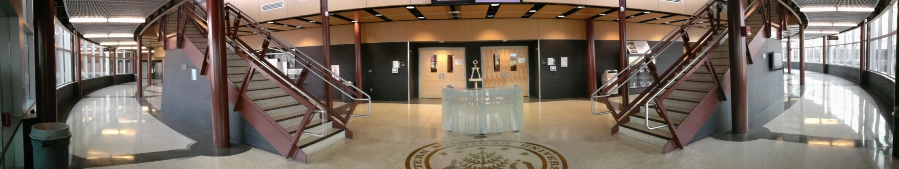
Background - Area

Slide 5
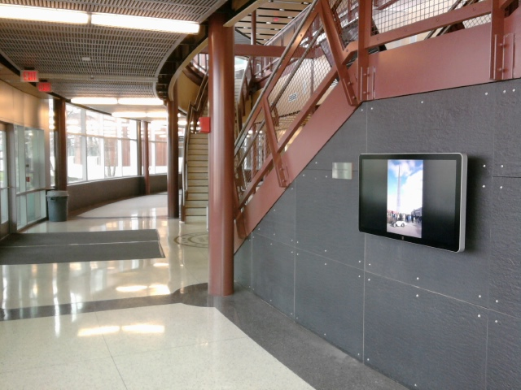

Slide 6
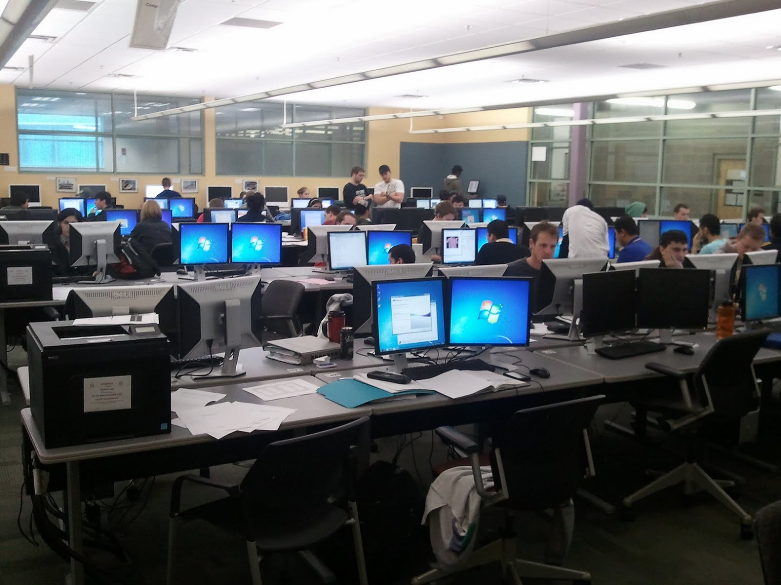
Background - Client
CAE Center
Administrators
Programmers
Contacts

Slide 7
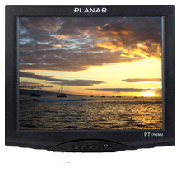
Background - The Origin
The old hardware
Planar PT191MU 19’’ Touchscreen
The old software

Slide 8
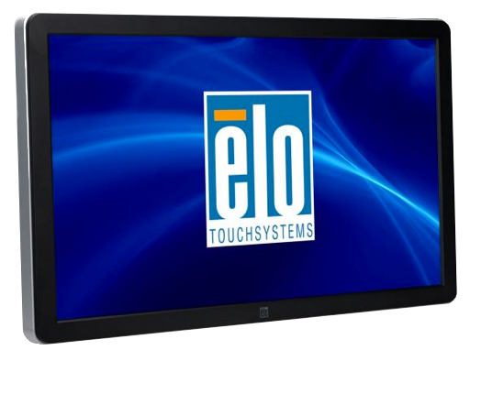
Background - The New
The new hardware

Slide 9
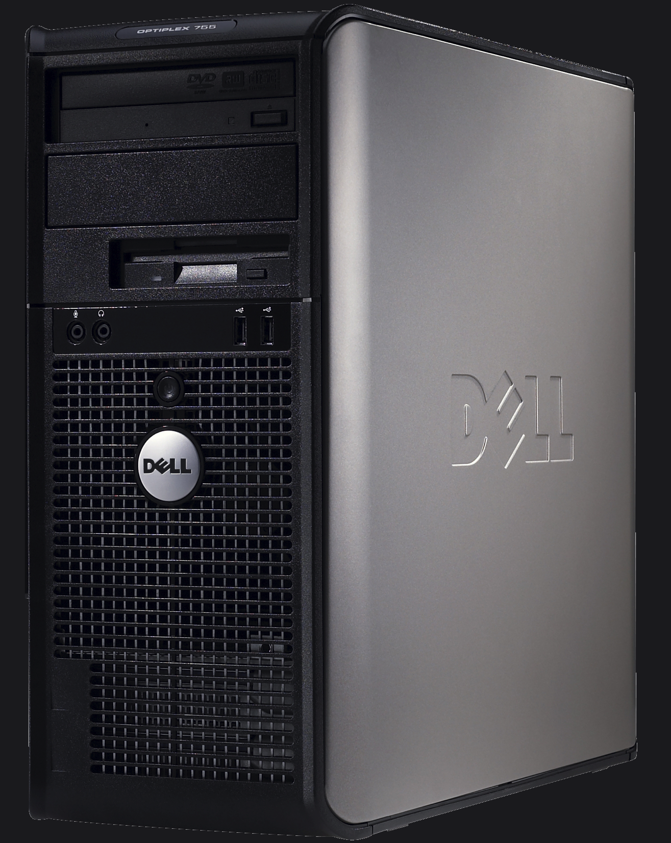
Dell Optiplex

Slide 10

Design Decisions - Environment
Microsoft Windows
Drivers
Windows Presentation Foundation – WPF
Resolution independent
Browser independent
Administrator familiarity
Locally Hosted
Network
Hardware Acceleration

Slide 11

Design Decisions - IDE
Microsoft Visual Studio
Ease of use
Continuous Tests
Git Extensions

Slide 12
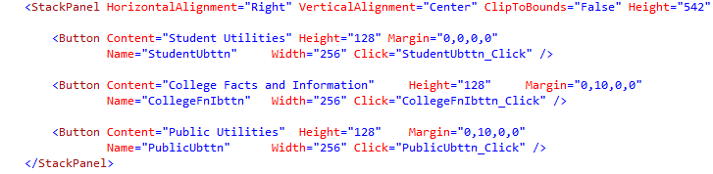
Design Decisions - Language
XAML – Our front end

Slide 13
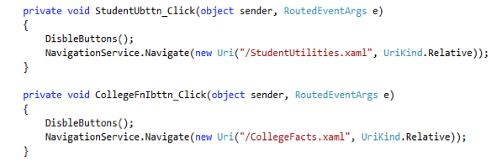
Design Decisions - Language
C# – Behind the scenes

Slide 14
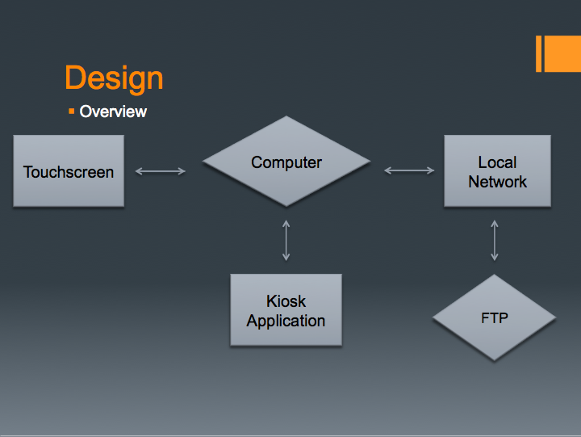
Design
Overview
Computer
Touchscreen
Local
Network
Kiosk
Application
FTP

Slide 15
Design – Background Layer
Window
Page
Middle
Directory
Read content in file directories
Parse the files
Package the input for the displaying page

Slide 16
Design – Front-End
XAML object control management
Integrates with C#
Data Bindings
App.xaml – “CSS like”
Windows, Frames, Pages

Slide 17
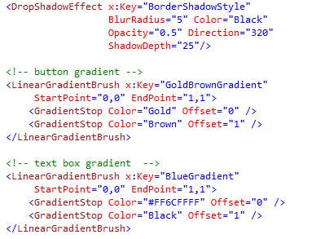
App.xaml

Slide 18
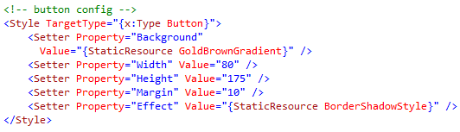
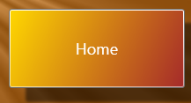
App.xaml - more

Slide 19
Design – The Structure
The design is similar to a web site structure.
Structures containing other structures forming a hierarchy

Slide 20

Window (with background)

Slide 21
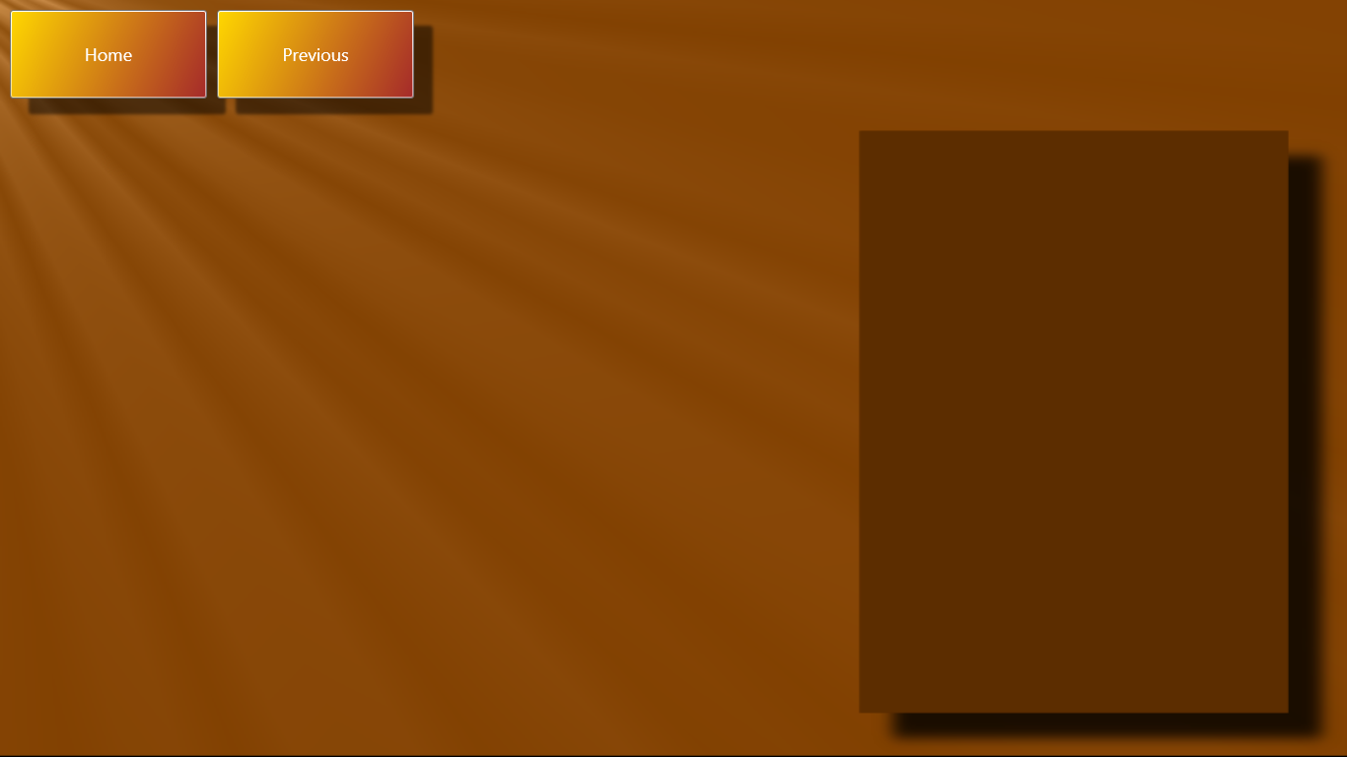
Top-level Objects

Slide 22
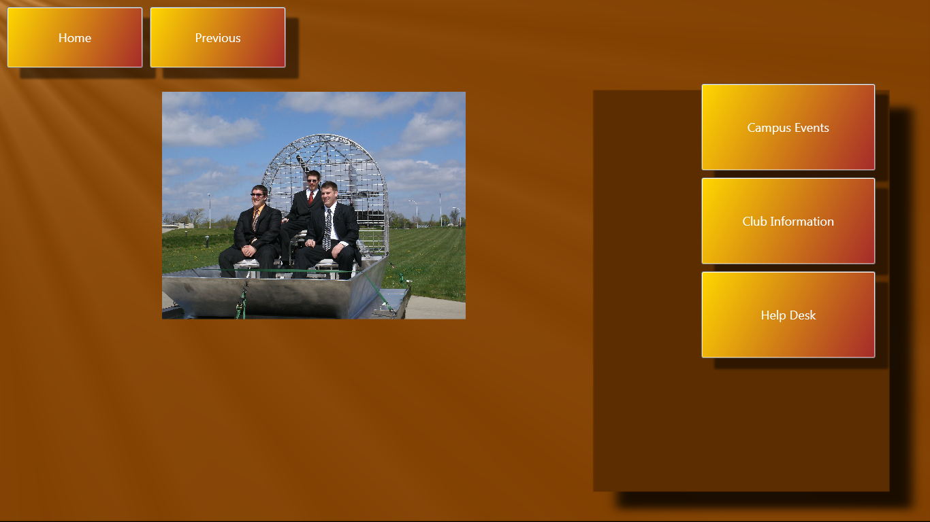
Page Frames

Slide 23
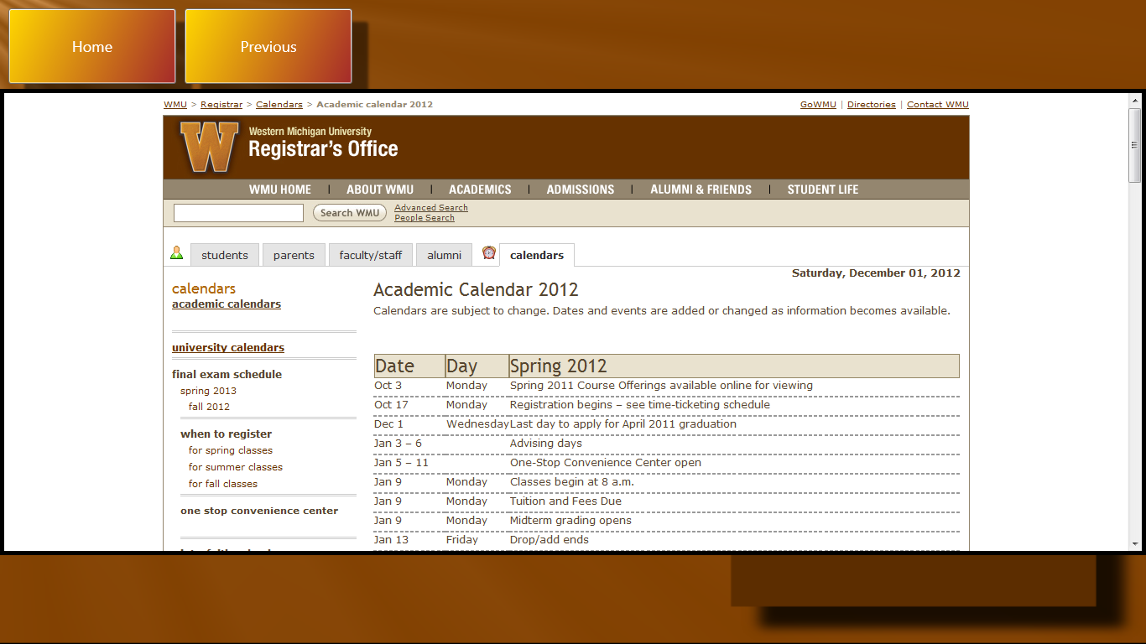
Page-level Objects

Slide 24
Implementation
Visual Studio
WPF
C#
the navigation work
XAML
The look and feel of the project.

Slide 25
Implementation – In Two Layers
Front end – Interface and what is seen
Back end – location of files and coding itself.

Slide 26
Implementation - Navigation
Home
Student
Club Info
Campus Events
Public
Campus Map
Info
Bus
Calendar

Slide 27
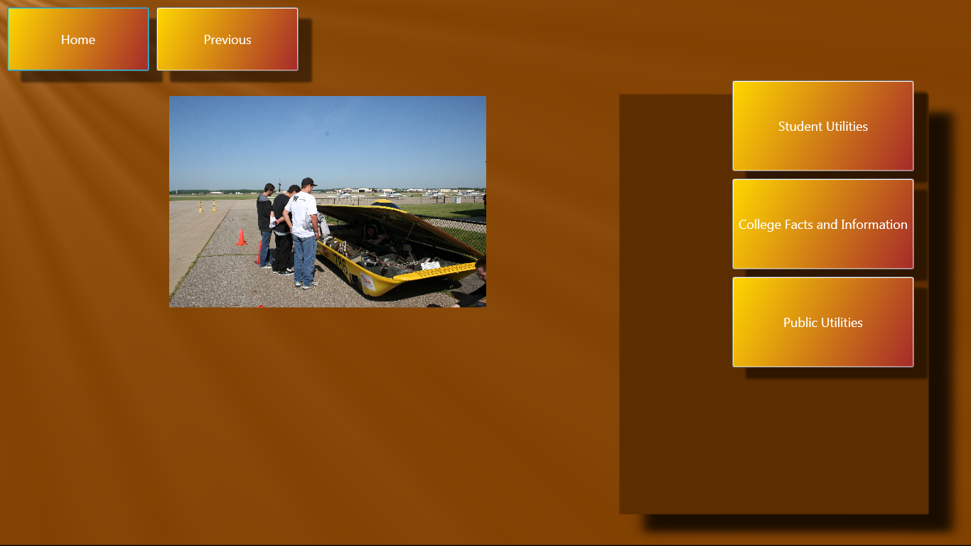
Implementation - Interface

Slide 28
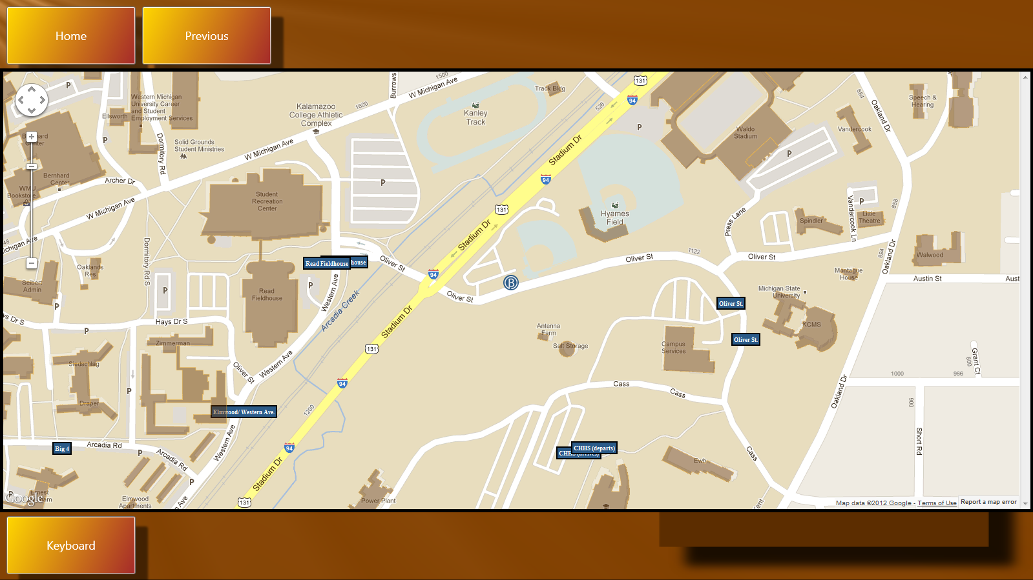
Implementation – Bus Track

Slide 29
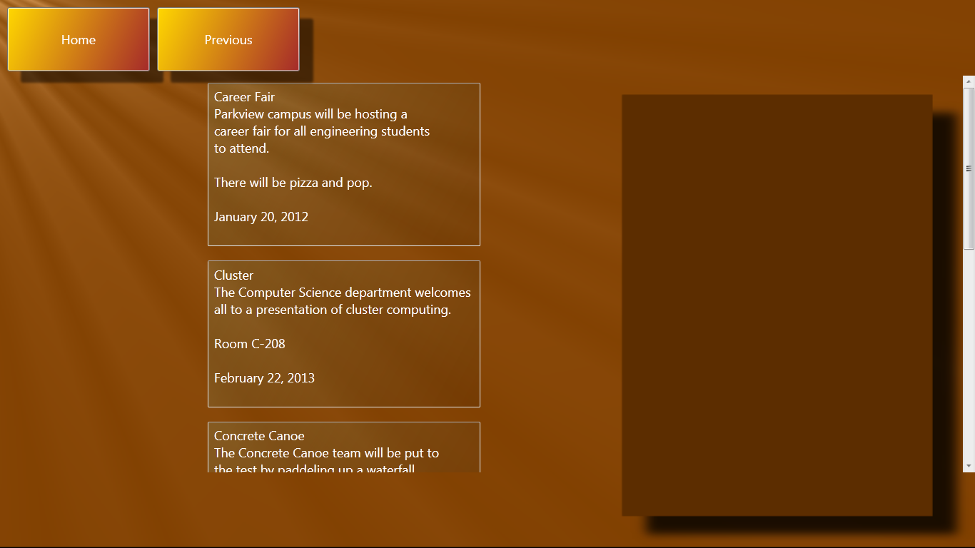
Implementation – Campus Events

Slide 30
Testing – What Was Used
Unit testing
Framework
Automation
Scripts
Functional testing

Slide 31

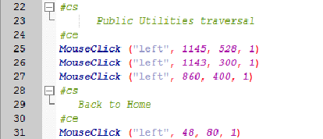

Testing – A Little More
AutoIt
Continuous Tests

Slide 32
Security
What security is currently in place?
Currently known issues.

Slide 33
Summary
What we have
Met the needs of client
XP philosophy – client interaction

Slide 34
Questions?

